Slide 1
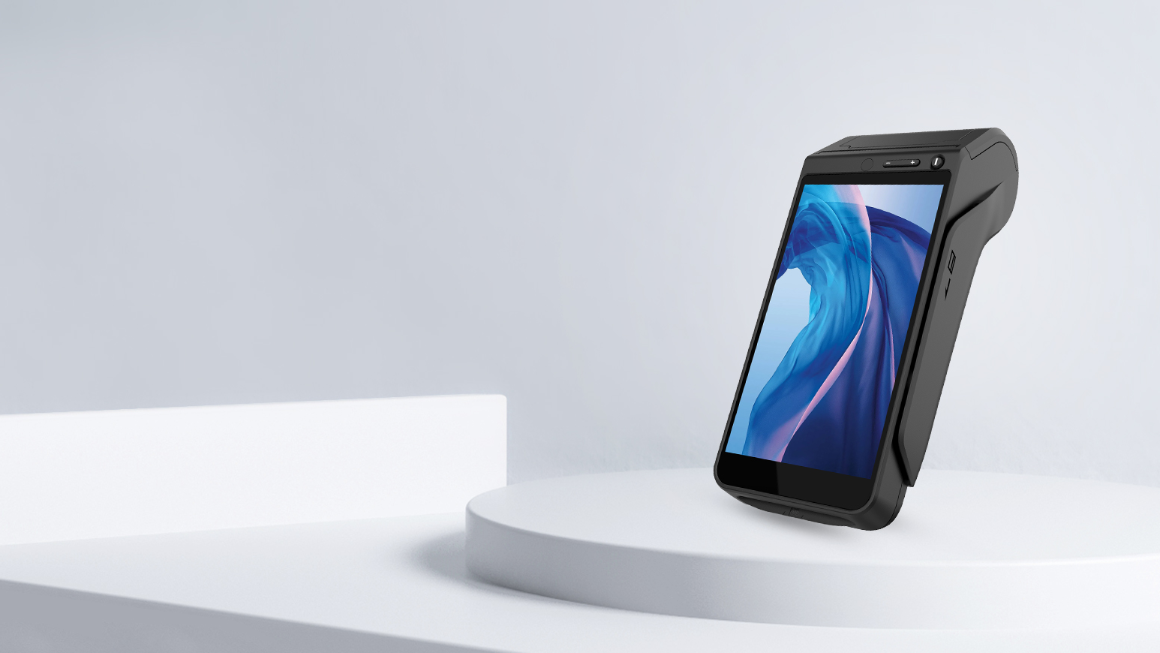
NEW9220
Smart POS Terminal
Inheriting the classic，Looking towards the future
www.newpostech.com

Slide 2
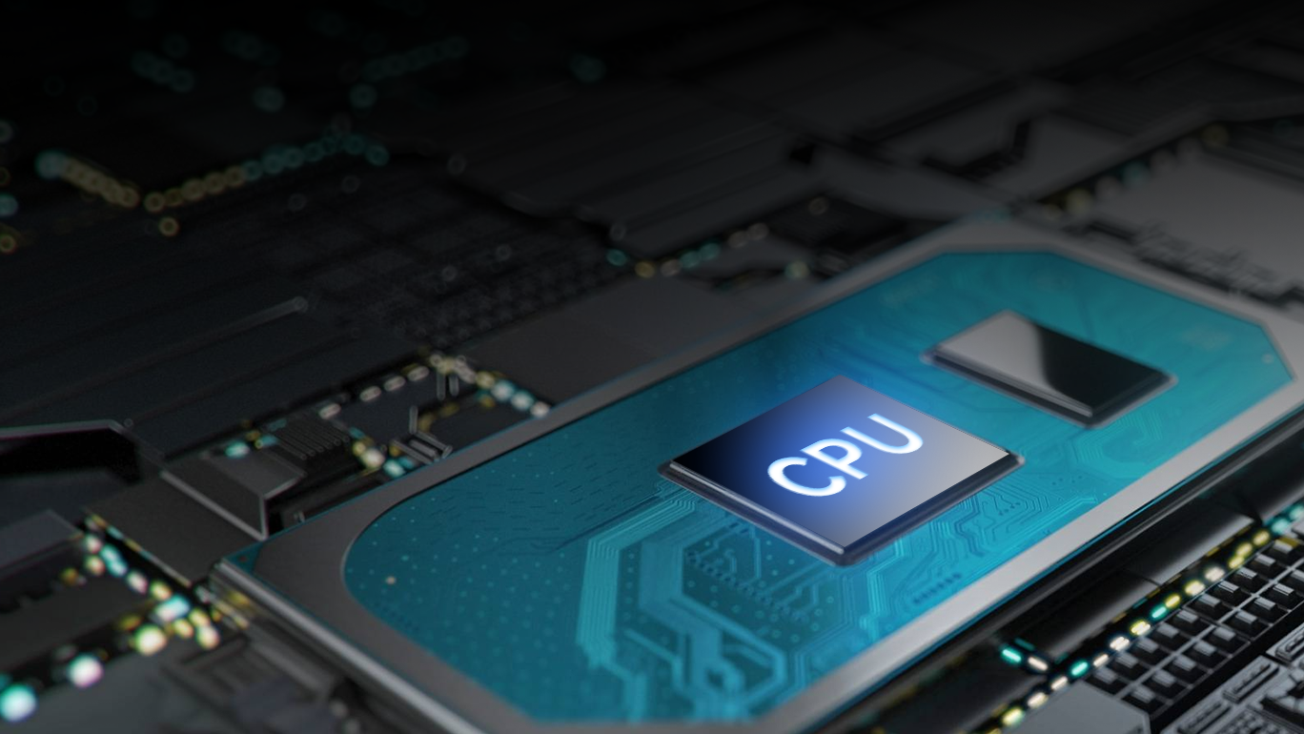
Powerful Performance
Superior Experience
The advanced quad-core 1.4GHz processor has strong performance and provides hardware assurance for a convenient and fast payment experience

Slide 3
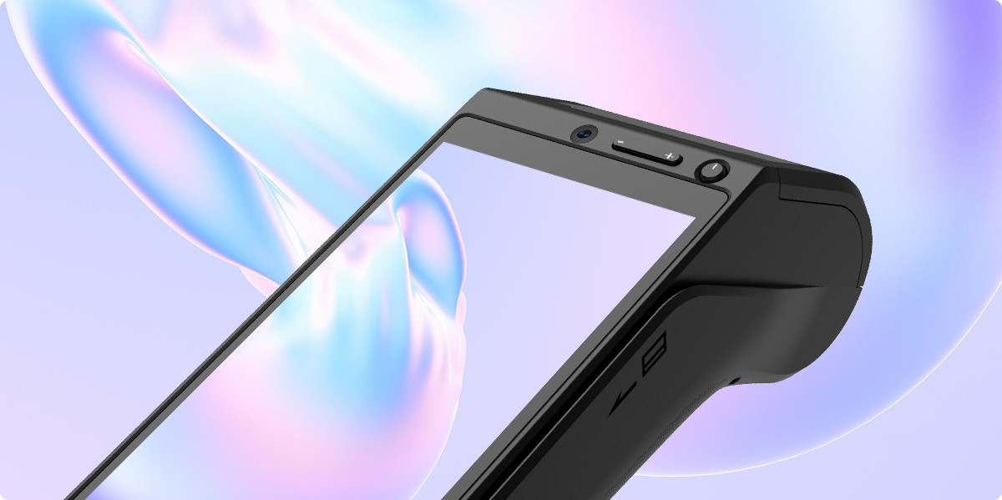
The 5.5-inch touch screen adjusts its brightness based on current lighting conditions and provides you vivid images and fascinating interaction experience.
Splendid Screen Display

Slide 4
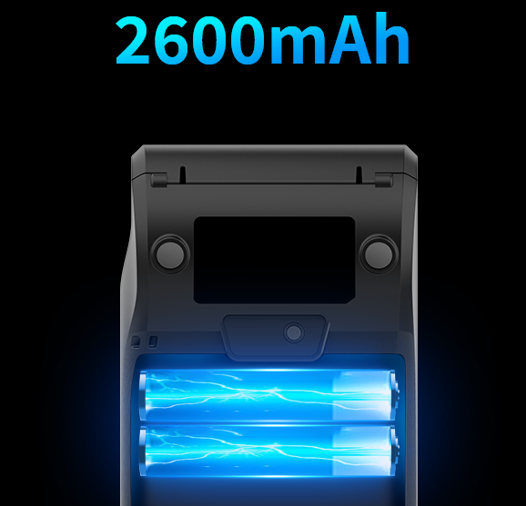
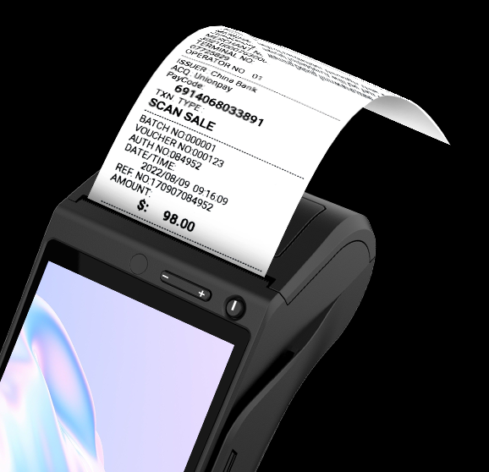
Long Battery Life
High-Speed and Portable Printer
Outstanding 7.2V/2600mAh battery capacity can support a full day's use with a single charge.
The NEW9220 has a built-in high-speed thermal printer, which can easily and quickly print receipts anytime, anywhere.

Slide 5
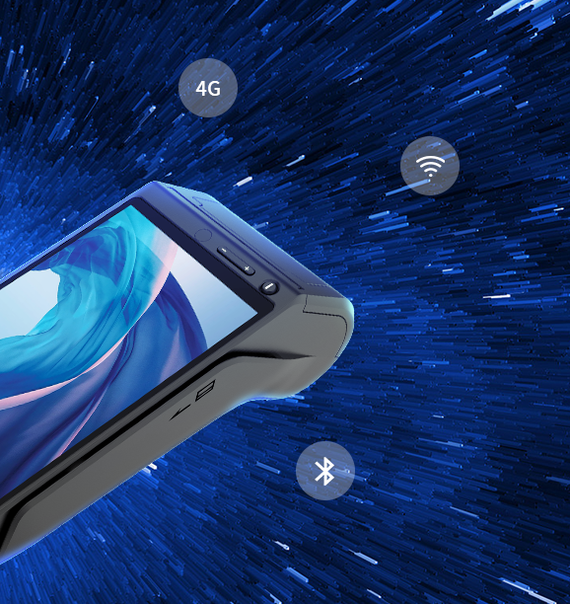
All Solutions
For Full Connection
With the help of solutions for full connection, you could make payment or process data rapidly and securely on the spot through: 2G/3G/4G, Wi-Fi，Bluetooth.

Slide 6
Dual Camera
0.3MP Front camera and 5MP autofocus rear camera catch every detail of the codes, and makes payment more rapid and safer.
0.3MP
5MP
Front
Rear

Slide 7
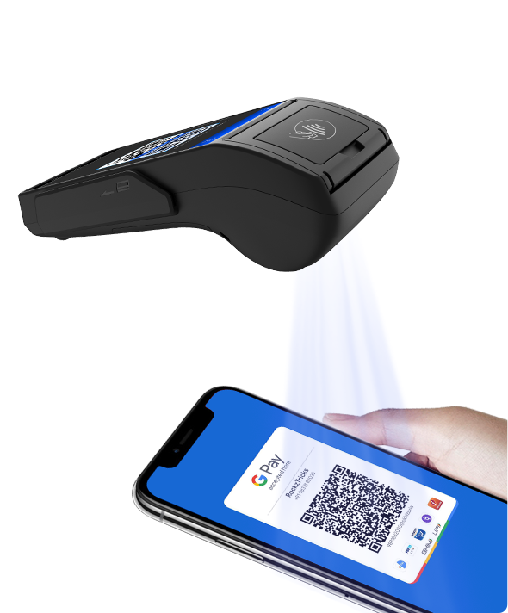
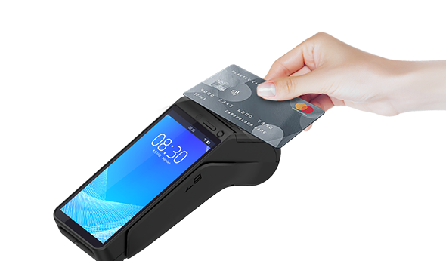
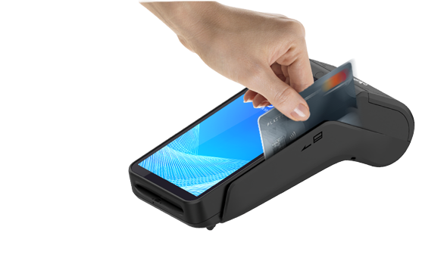
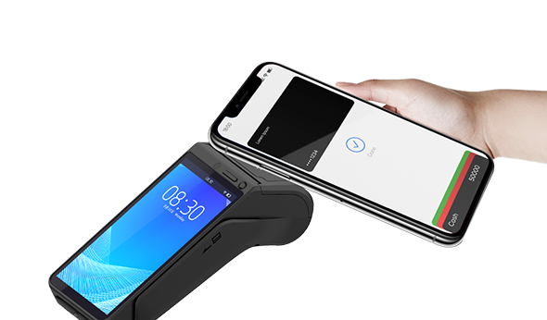
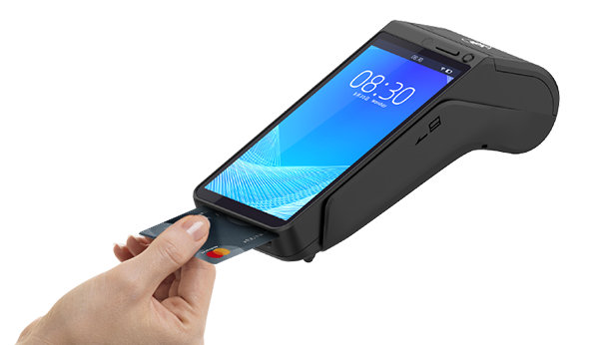
Supporting All Payments
It supports various payment methods, such as magnetic card, IC card, contactless transaction and code scanning transaction.
A machine can be used for various forms, making collection simple.
QR Code
Contactless Card
Magnetic Card
NFC
IC Card

Slide 8
NEW9220 Specifications
CPU | Quad-core Cortex-A53
Memory | 1GB RAM+8GB ROM 2GB RAM+16GB ROM（optional） up to 256GB
OS | Asmart
Display | 5.5"HD 720×1280 Pixels
Communication | 4G,WiFi,GPS,Bluetooth
Card Reader | Magnetic Card Reader Smart Card Reader Contactless Card Reader
Location | GPS/BEIDOU/GLONASS
Camera | Front：0.3 MP Rear：5 MP Reads 1D&2D Codes
Printer | High-Speed Thermal printer Paper Width: 58mm Diameter: 40mm
Peripheral Ports | 1 xType-C USB
Buttons | Power button Volume +/-
Card Slots | 2xSIM+1xSAM 2xSIM+2xSAM(optional)
Battery | Rechargeable Li-ion Battery 7.2V/2600mAh
Power | Input: 100-240V AC,50/60Hz Output:5V DC,2A
Dimensions | L×W×H (mm):192×84×63.5 Wight：486g
Certifications | PCI PTS 6.X, EMV LEVEL 1&2, PBOC3.0, Visa Pay Wave, Master Card Pay Pass, American Expresspay Discover JCB Union Pay CE
Working environment | Temperature: 0°C~50°C(32°F~122%F) Humidity: 10%~90%(non-condense)
Storage environment | Temperature: -20°C~60°C(-4~140°F) Humidity: 5% ~ 95%(non-condense)

